Slide 1
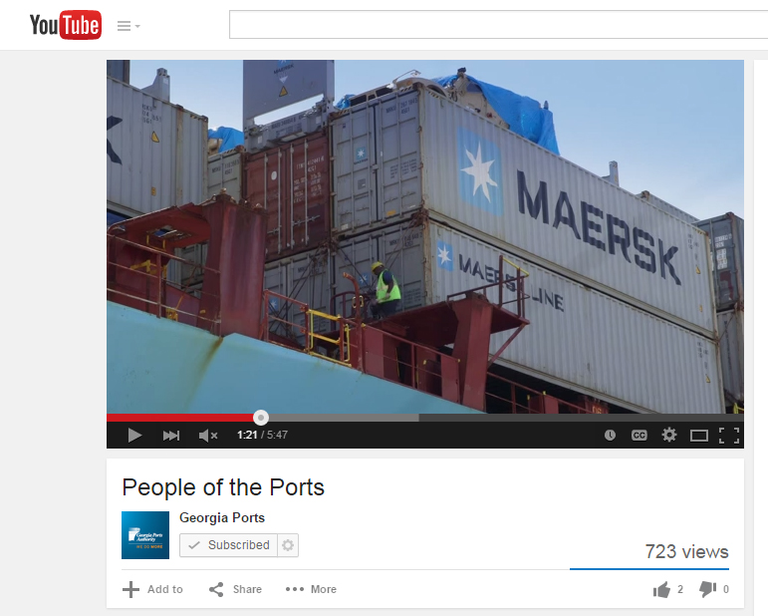
Georgia Ports Authority
People of the Ports
Video

